Slide 1
Bunratty Village and River
Deployment Step of Project: “Me myself and I”

Slide 2
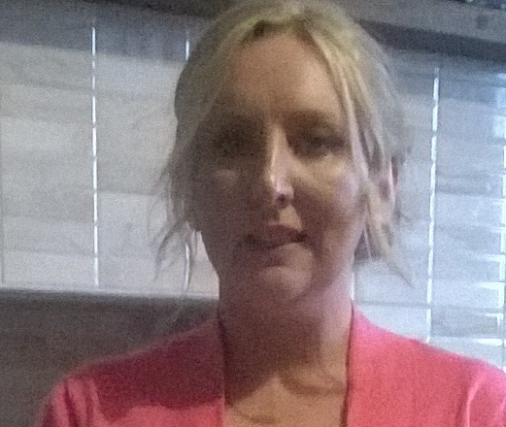
Student Details
Student Name: Sinéad Boyce
Knumber: k00121609
Subject: Web Development

Slide 3
Links to the presentation
Link to website: http://k001216094lit.bitballoon.com
Link to blog: https://htpwwwsabassignment.wordpress.com/2016/11/13/my-blogs-for-the-web-development-assignment_-me-myself-and-i/
Link to report:

